Slide 1

BCA Ist Semester BCA IV Semester COMPUTER SYSTEM AND ARCHITECTURE Course Code: BCAC0025
Presented by:
Mr.AMAN DEEP SINGH
Assistant Professor, Dept. Of CEA
GLA University, Mathura

Slide 2
Karnaugh Maps
Karnaugh maps (K-maps) are graphical representations of boolean functions.
One map cell corresponds to a row in the truth table.
Also, one map cell corresponds to a minterm or a maxterm in the boolean expression
Multiple-cell areas of the map correspond to standard terms.

Slide 3
Two-Variable Map
x₁
0
1
x₂
0
1
x₂
x₁
0
m₀
m₁
0
m₀
m₂
0
1
0
2
OR
1
m₂
m₃
2
3
1
m₁
m₃
1
3
NOTE: ordering of variables is IMPORTANT for f(x₁,x₂), x₁ is the row, x₂ is the column.
Cell 0 represents x₁’x₂’; Cell 1 represents x₁’x₂; etc. If a minterm is present in the function, then a 1 is placed in the corresponding cell.

Slide 4
2-Variable Map -- Example
f(x₁,x₂) = x₁’x₂’+ x₁’x₂ + x₁x₂’ = m₀ + m₁ + m₂ = x₁’ + x₂’
1s placed in K-map for specified minterms m₀, m₁, m₂
Grouping (ORing) of 1s allows simplification
What (simpler) function is represented by each dashed rectangle?
x₁’ = m₀ + m₁
x₂’ = m₀ + m₂
Note m₀ covered twice
x₁ | 0 | 1
0 | 1 | 1
1 | 1 | 0
x₂
0
1
2
3

Slide 5
Minimization as SOP using K-map
Enter 1s in the K-map for each product term in the function
Group adjacent K-map cells containing 1s to obtain a product with fewer variables. Group size must be in power of 2 (2, 4, 8, …)
Handle “boundary wrap” for K-maps of 3 or more variables.
Realize that answer may not be unique

Slide 6
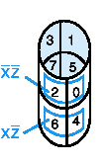
Three-Variable Map
yz
00
01
11
10
x
0
m₀
m₁
m₃
m₂
0
1
3
2
1
m₄
m₅
m₇
m₆
4
5
7
6
-Note: variable ordering is (x,y,z); yz specifies column, x specifies row.
-Each cell is adjacent to three other cells (left or right or top or bottom or edge wrap)

Slide 7
Three-Variable Map (cont.)
minterm
The types of structures that are either minterms or are generated by repeated application of the minimization theorem on a three variable map are shown at right. Groups of 1, 2, 4, 8 are possible.
group of 2 terms
group of 4 terms

Slide 8
Simplification
Enter minterms of the Boolean function into the map, then group terms
Example: f(a,b,c) = a’c + abc + bc’
Result: f(a,b,c) = a’c+ b
bc
a
 | 1 | 1 | 1
 |  | 1 | 1
 | 1 | 1 | 1
 |  | 1 | 1

Slide 9
More Examples
yz X | 00 | 01 | 11 | 10
0 |  |  | 1 | 1
1 |  | 1 | 1
f₁(x, y, z) = ∑ m(2,3,5,7)
f₂(x, y, z) = ∑ m (0,1,2,3,6)
f₁(x, y, z) = x’y + xz
1 | 1 | 1 | 1
 |  |  | 1
f₂(x, y, z) = x’+yz’

Slide 10
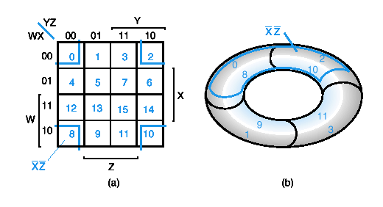
Four-Variable Maps
YZ
00
01
11
10
_{WX}
00
m₀
m₁
m₃
m₂
01
m₄
m₅
m₇
m₆
11
m₁₂
m₁₃
m₁₅
m₁₄
10
m₈
m₉
m₁₁
m₁₀
Top cells are adjacent to bottom cells. Left-edge cells are adjacent to right-edge cells.
Note variable ordering (WXYZ).

Slide 11
Four-variable Map Simplification
One square represents a minterm of 4 literals.
A rectangle of 2 adjacent squares represents a product term of 3 literals.
A rectangle of 4 squares represents a product term of 2 literals.
A rectangle of 8 squares represents a product term of 1 literal.
A rectangle of 16 squares produces a function that is equal to logic 1.

Slide 12
Example
Simplify the following Boolean function (A,B,C,D) = ∑m(0,1,2,4,5,7,8,9,10,12,13).
First put the function g( ) into the map, and then group as many 1s as possible.
ab
_{cd}
1
1
1
1
1
1
1
1
1
1
1
1
1
1
1
1
1
1
1
1
1
1
g(A,B,C,D) = c’+b’d’+a’bd

